Slide 1
A forced-choice measure of preferred symptom change in depression
Johannes Keil
Master’s thesis Intern at AIM-Lab
MSc student, Maastricht University

Slide 2

Roadmap
Why study preference?
Findings
Discussion
Next steps
Questions for you

Slide 3
Person-centred care is a value on its own
“[The NHS] should support individuals to promote and manage their own health. NHS services must reflect, and should be coordinated around and tailored to, the needs and preferences of patients, their families and their carers.” (NHS Constitution, 2012)

Slide 4
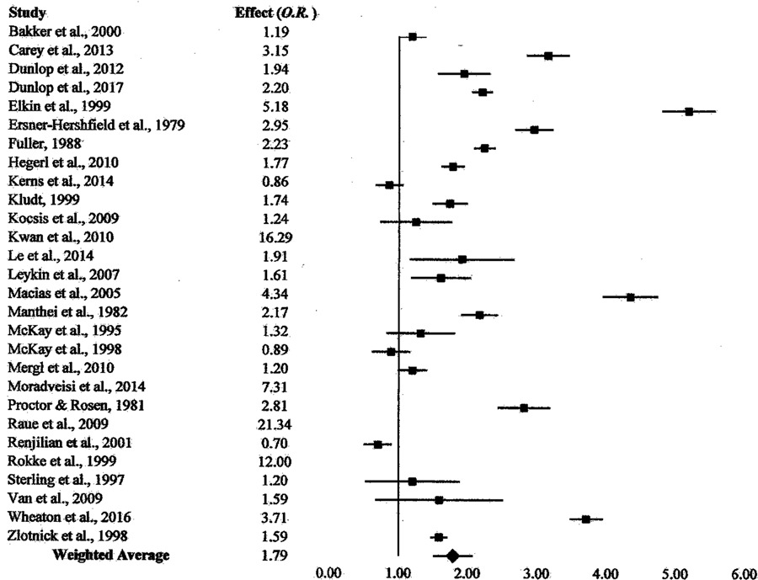
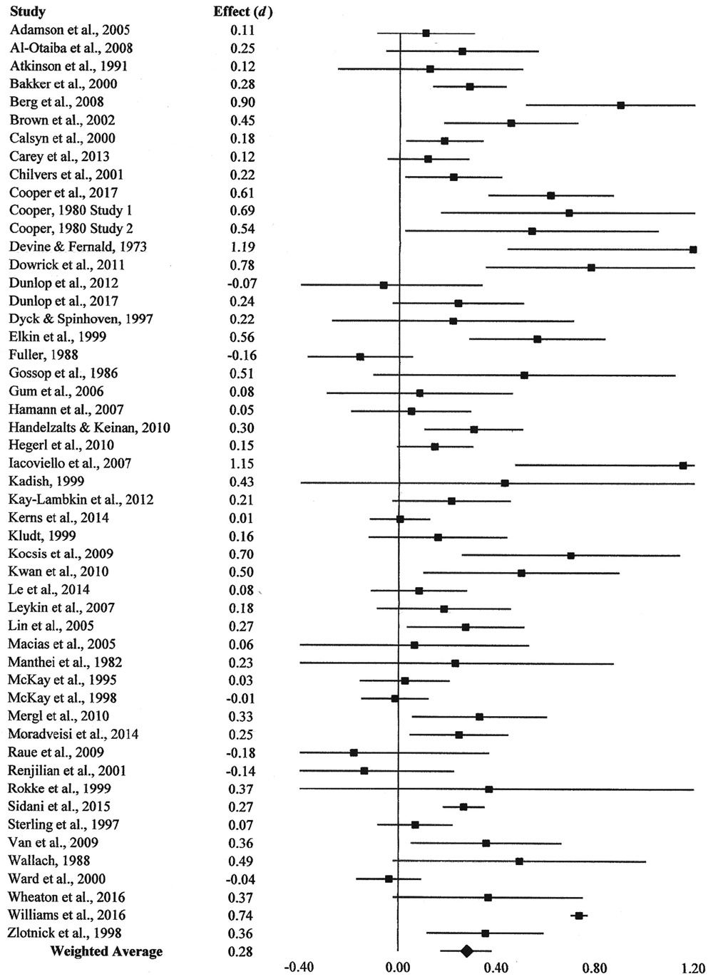
Lower dropout and better outcomes in psychotherapy after preference adjustment (Swift et al., 2018)

Slide 5
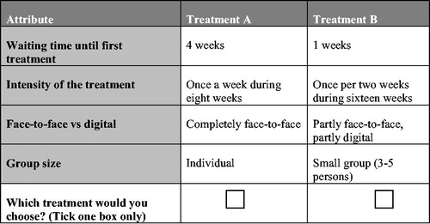
How has preference been conceptualised? The discrete forced choice paradigm
Lokkerbol et al. (2018)

Slide 6
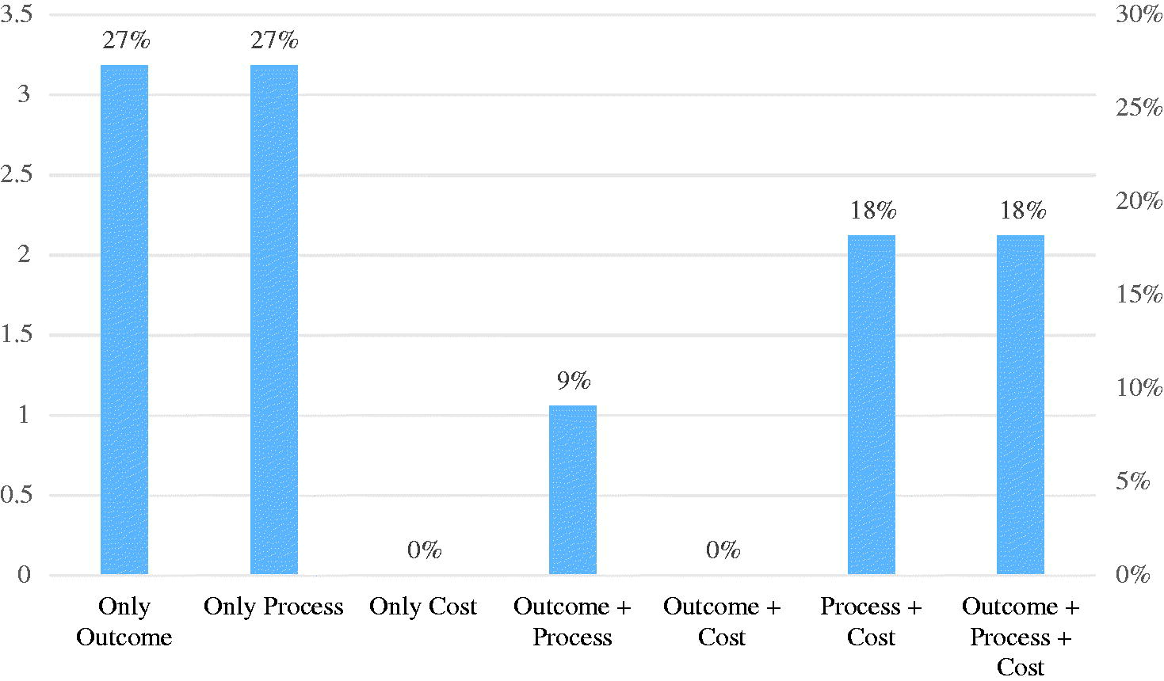
What sorts of preferences have been looked at in forced-choice so far? - Tünneßen et al. (2019)

Slide 7
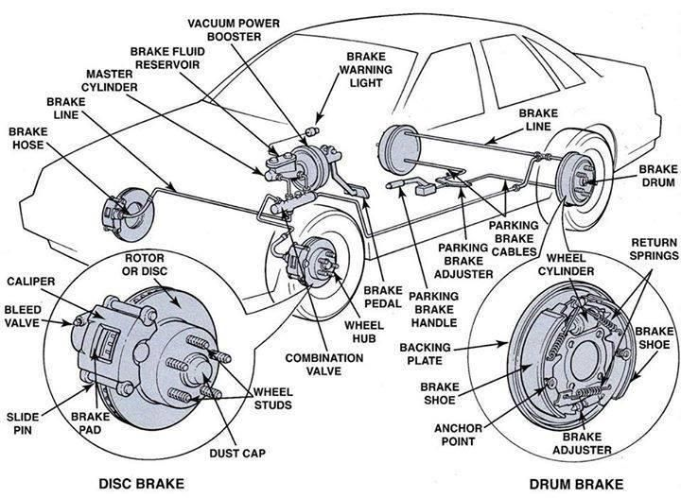
... polemically:
“Your car has depression. Its brakes are loose, and the wheel has come off. Would you like a screwdriver or a wrench to fix it? Would that change if the wrench was available 10 months earlier than the screwdriver?”

Slide 8
The problem
We need to map symptoms/problems onto solutions
Existing tools ignore what the problem is and skip directly to the solution
This conflates two questions: (a) what symptoms would I like to prioritise and (b) what treatment activities best address those symptoms, given all relevant practical constraints and preferences?

Slide 9
The project goal
Can we measure preference for symptom change with forced choice, and is this worthwhile?

Slide 10
The research questions
Can we reliably measure preference for symptom change using a forced-choice method, within and across timepoints?
Can preference for symptom change can be predicted from symptom severity, impact and frequency?
Do harder choices (i.e., between more similarly ranked-symptoms) take longer?
What can we learn about the average pattern of preferences?
How much variability is there in preferences?
Are there groups that are particularly indecisive?
Reliability
Validity
Potential
Uses

Slide 11
Method
Choose symptoms from list of 52
(Fried & Nesse, 2015)
190 trials forced choice task between chosen symptoms
Likert ratings severity, frequency, impact
Cloud-research study on 128 participants with likely depression (CESD-score > 16).
Procedure repeated at two timepoints

Slide 12
The forced choice task
“If you could make one of these symptoms go away, which one would you pick?”
Feeling depressed.
Having restless sleep.

Slide 13
Results

Slide 14
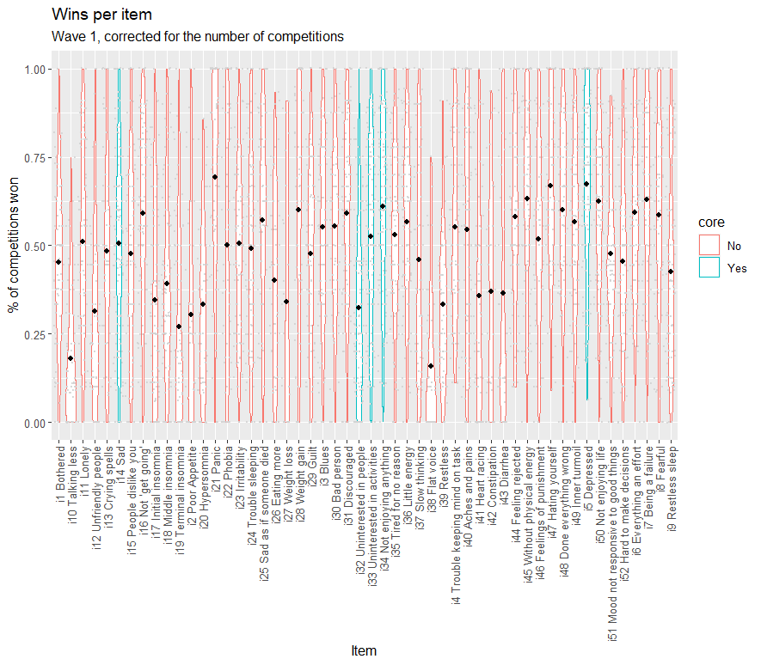

Slide 15
Reliability: Internal consistency
Cronbach’s alpha is not appropriate for ‘ipsative’ forced choice data (Meade et al., 2004), since we expect negative inter-item correlation structure
Solutions:
F-test of overall profile (Meade et al., 2004)
Measure proportion of ‘random responders’ with non-transitive response patterns (Mazzuchi et al., 2008; Kendall, 1962; Davis, 1963)
The entropy of a discrete distribution is maximal for a uniform distribution (e.g. Shannon, 1952). Measure proportion of ‘random responders’ whose response entropy is not significantly smaller than expected at chance using a permutation test

Slide 16
Reliability: Internal consistency
Overall response pattern differed significantly from chance in wave 1, F(51, 4243) = 14.19, p < .001, and wave 2 F(51, 3757) = 11.96, p < .001
Discordant results on the rate of random responders between the two analyses.
Entropy-test likely highly conservative, with high false-negative rate in simulations (19.4%). Good simulated false positive rates for transitivity (5.3%) and entropy (<0.1%)
% non-random responders | Transitivity | Entropy
Wave 1 | 100% | 60%
Wave 2 | 100% | 53%

Slide 17
Reliability: Test-retest
Again, simple correlation is not appropriate
For each participant, compute Aitchison’s distance (van Eijnatten et al., 2015) between T1 and T2, and test whether this is smaller than would be expected at chance
Overall, 87.07% significant, indicating that most participants’ responses were more similar than expected at random.
Large AD
Small AD

Slide 18
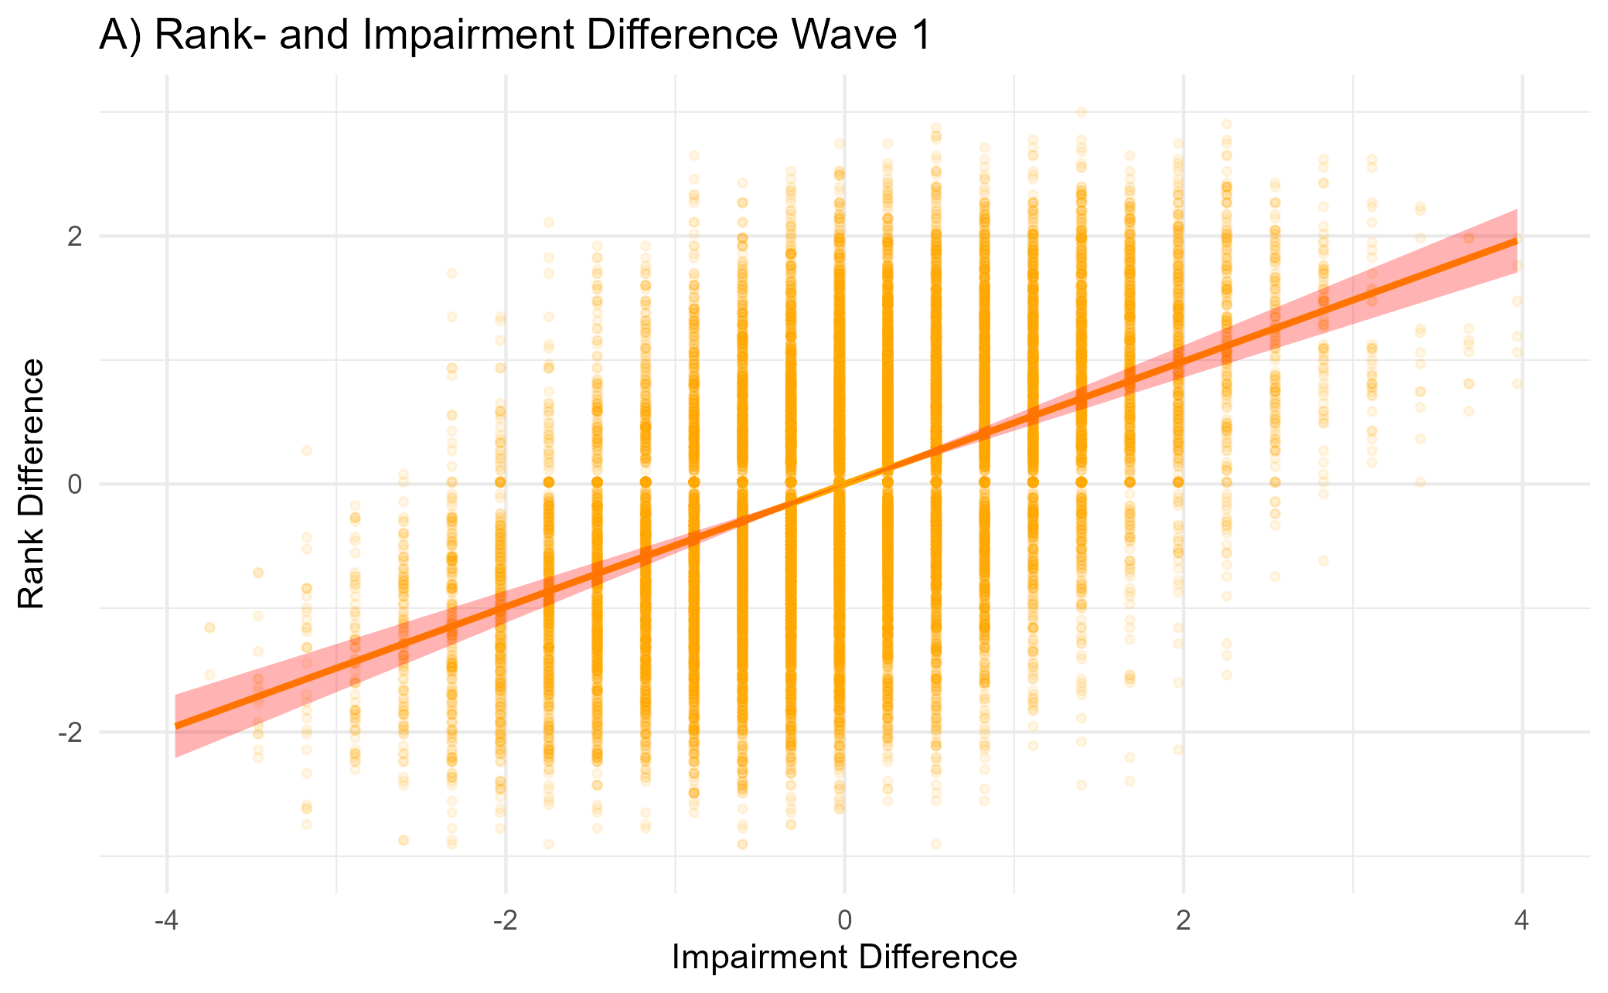
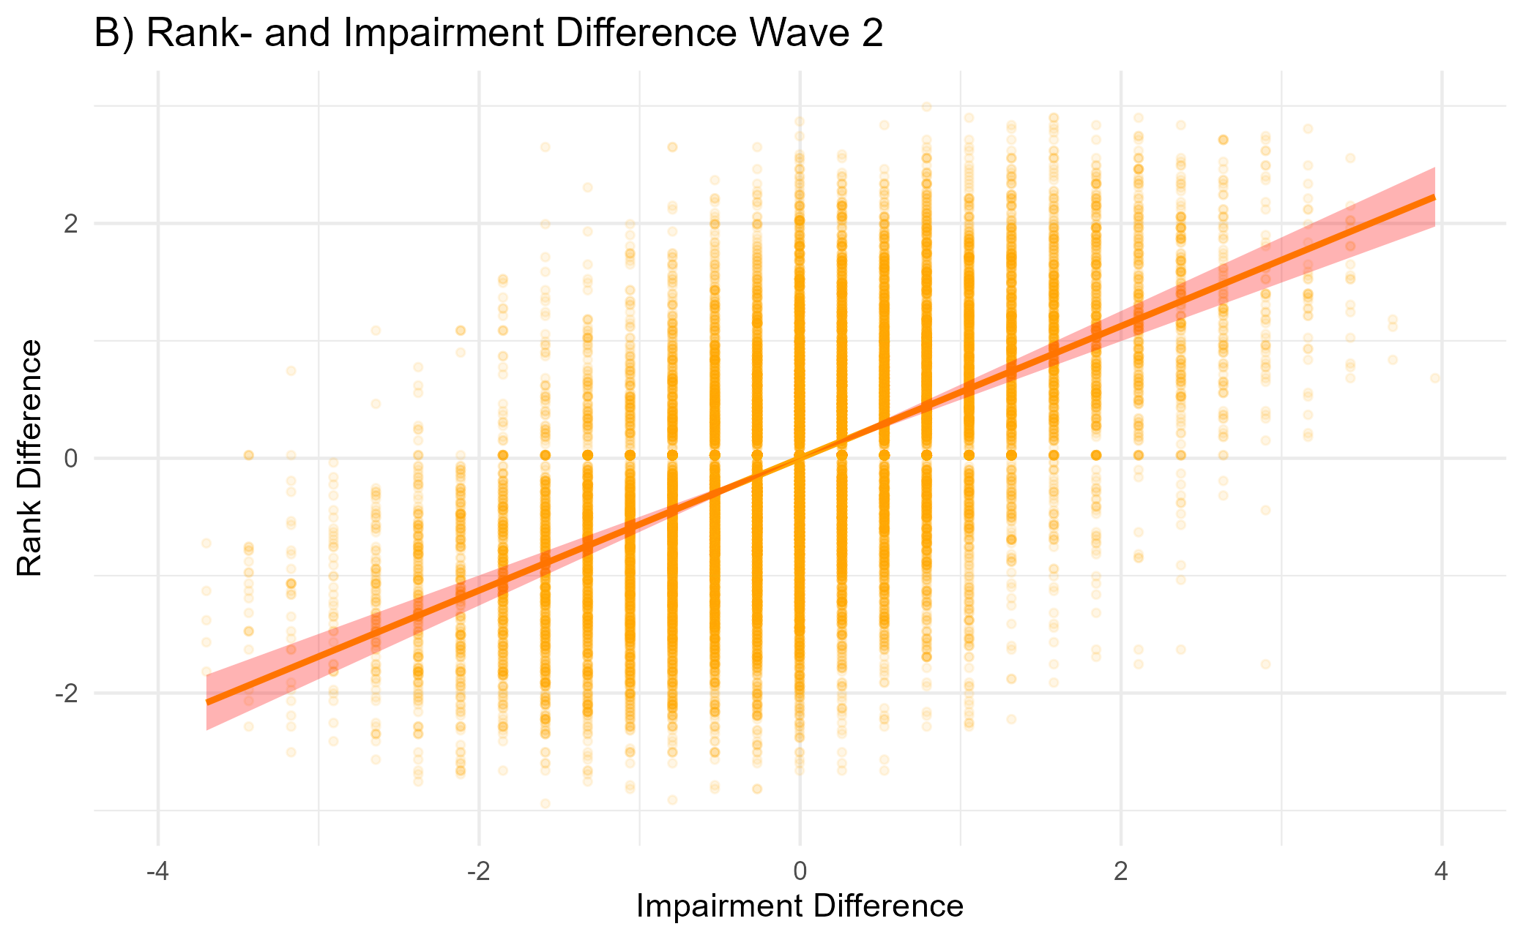
Validity: Severity, Frequency, Impact
beta = 0.49, p < .001
beta = 0.56, p < .001

Slide 19
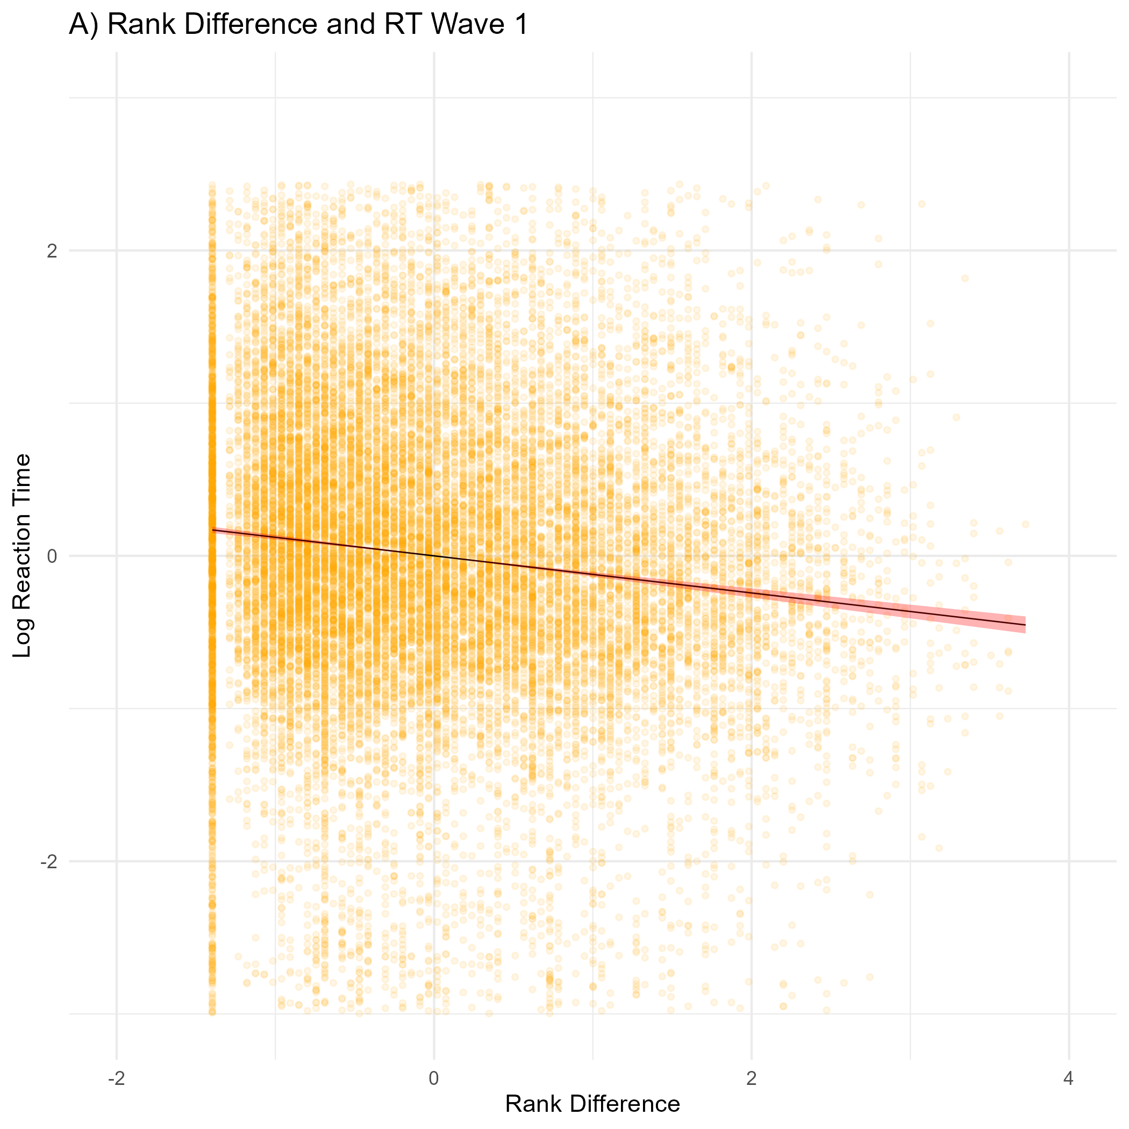
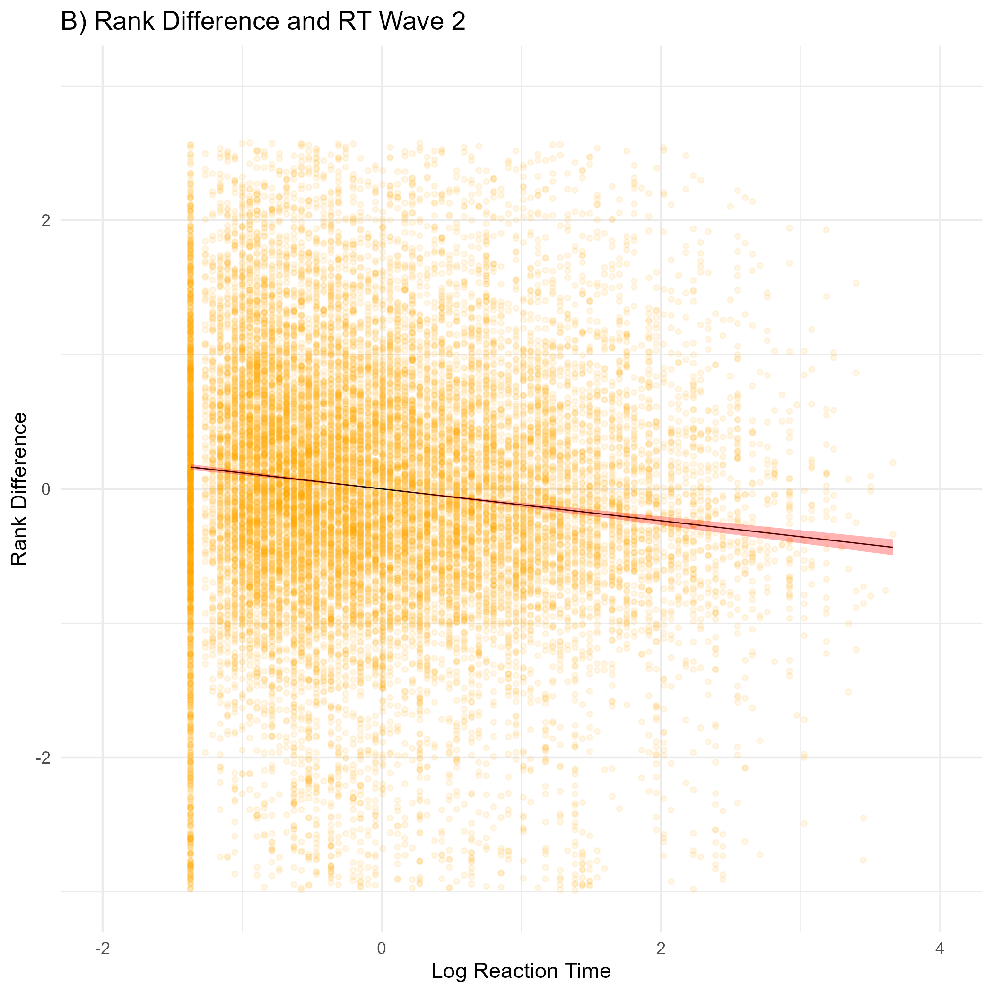
Validity: Rank difference and reaction time
beta = -.12, p < .001
beta = -.12, p < .001

Slide 20
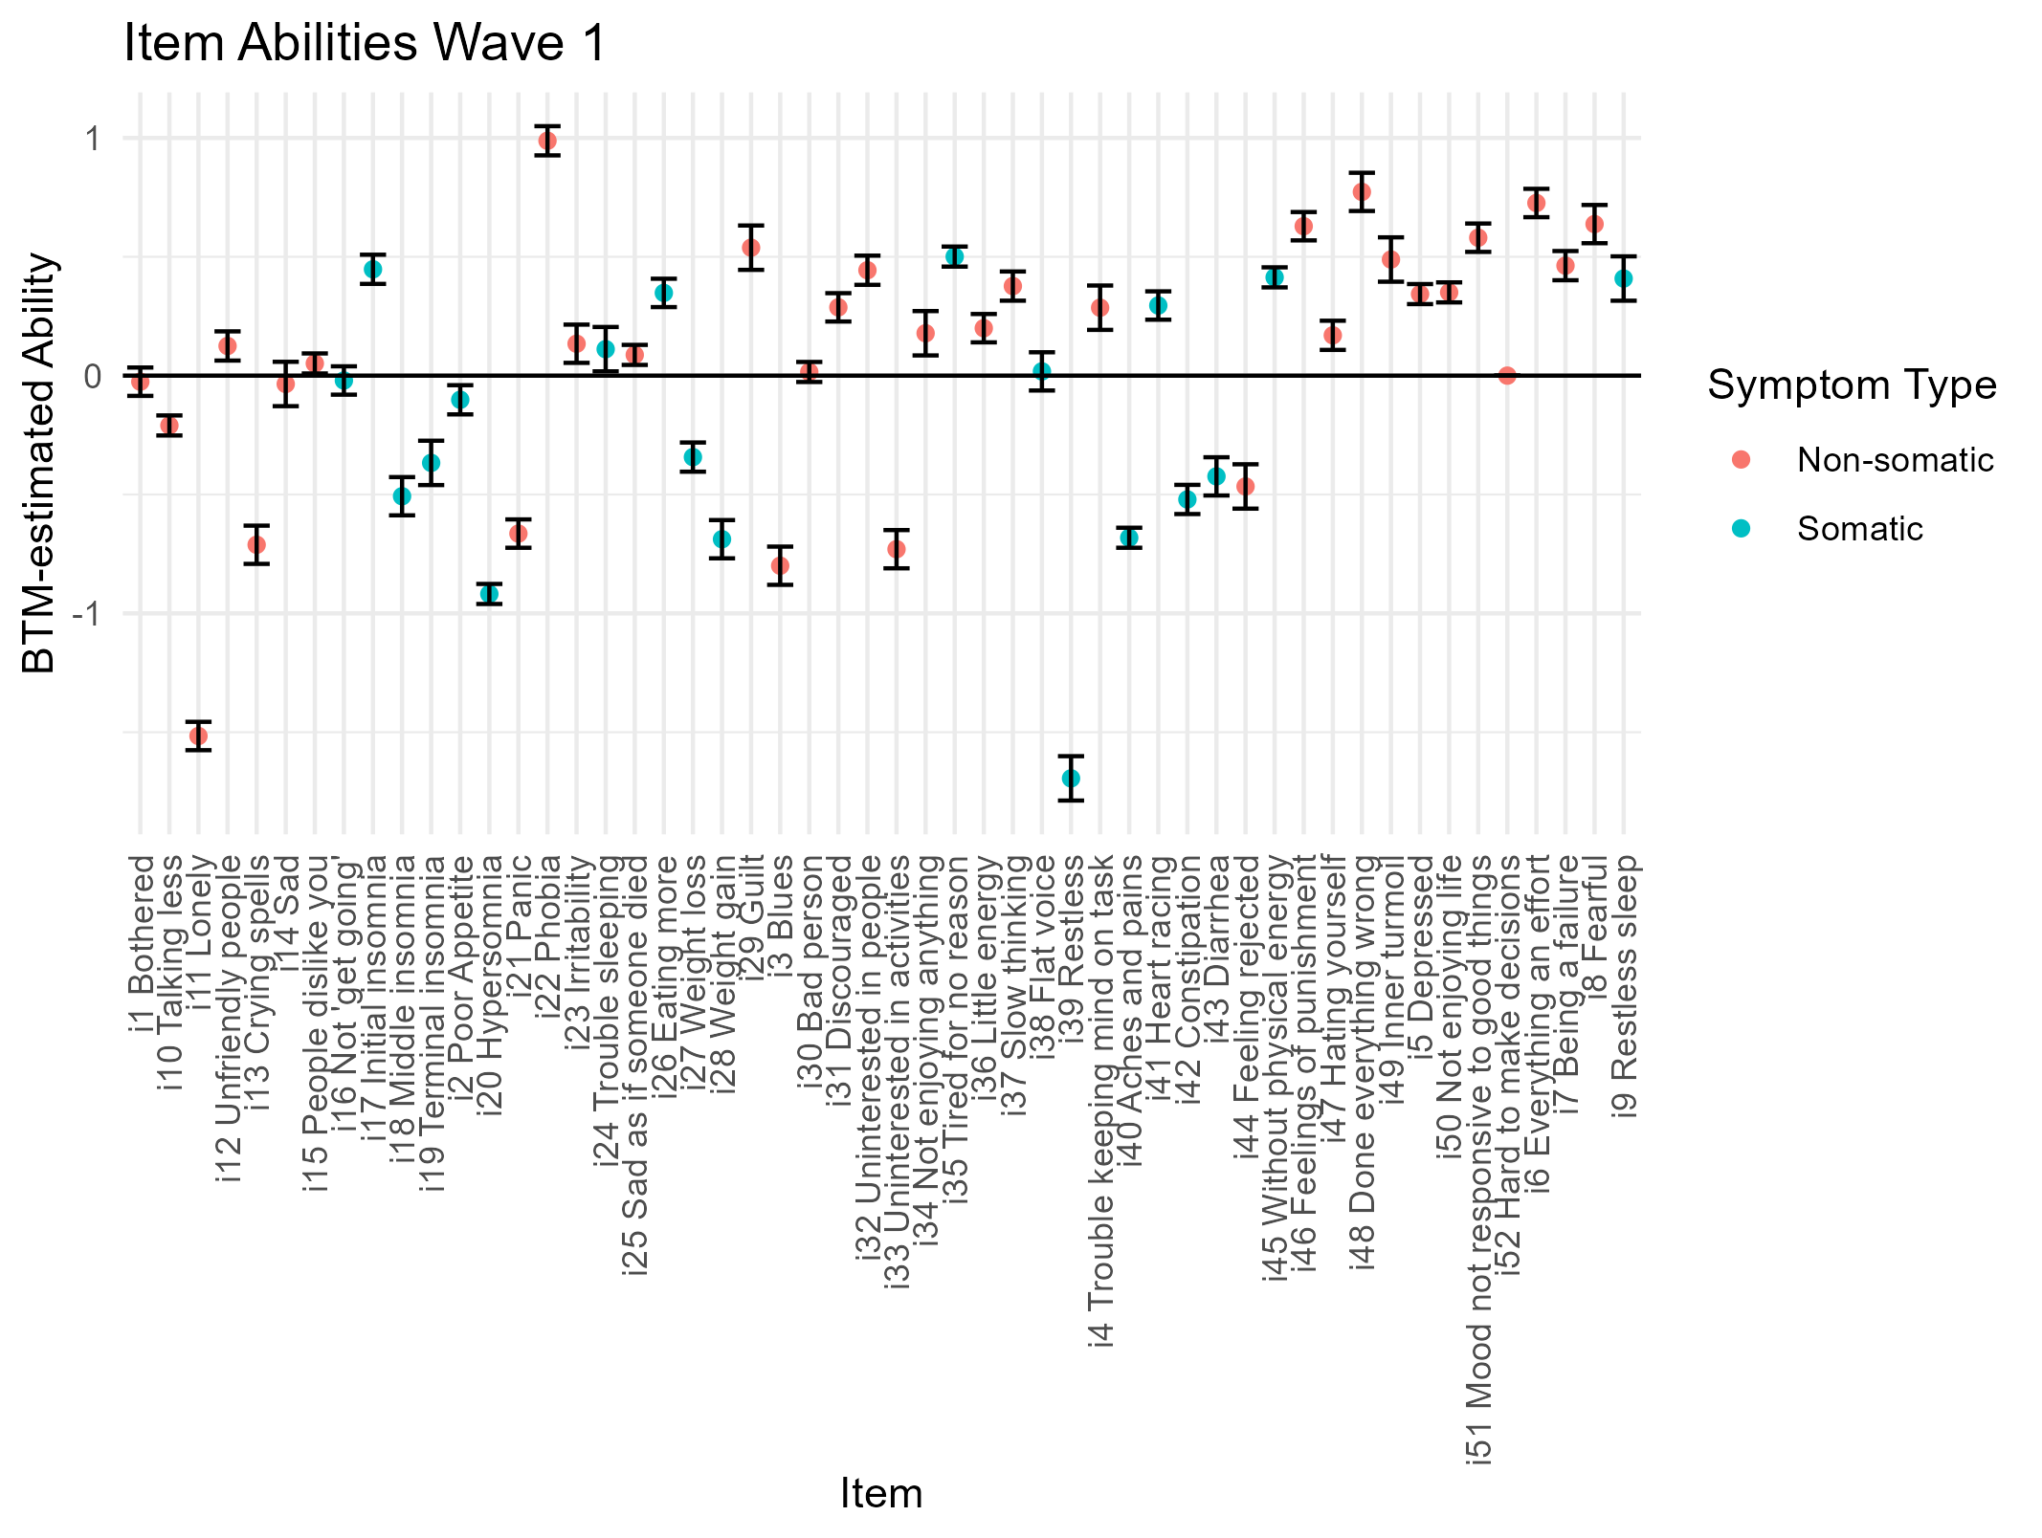
Usefulness: What can we learn about the overall pattern?

Slide 21
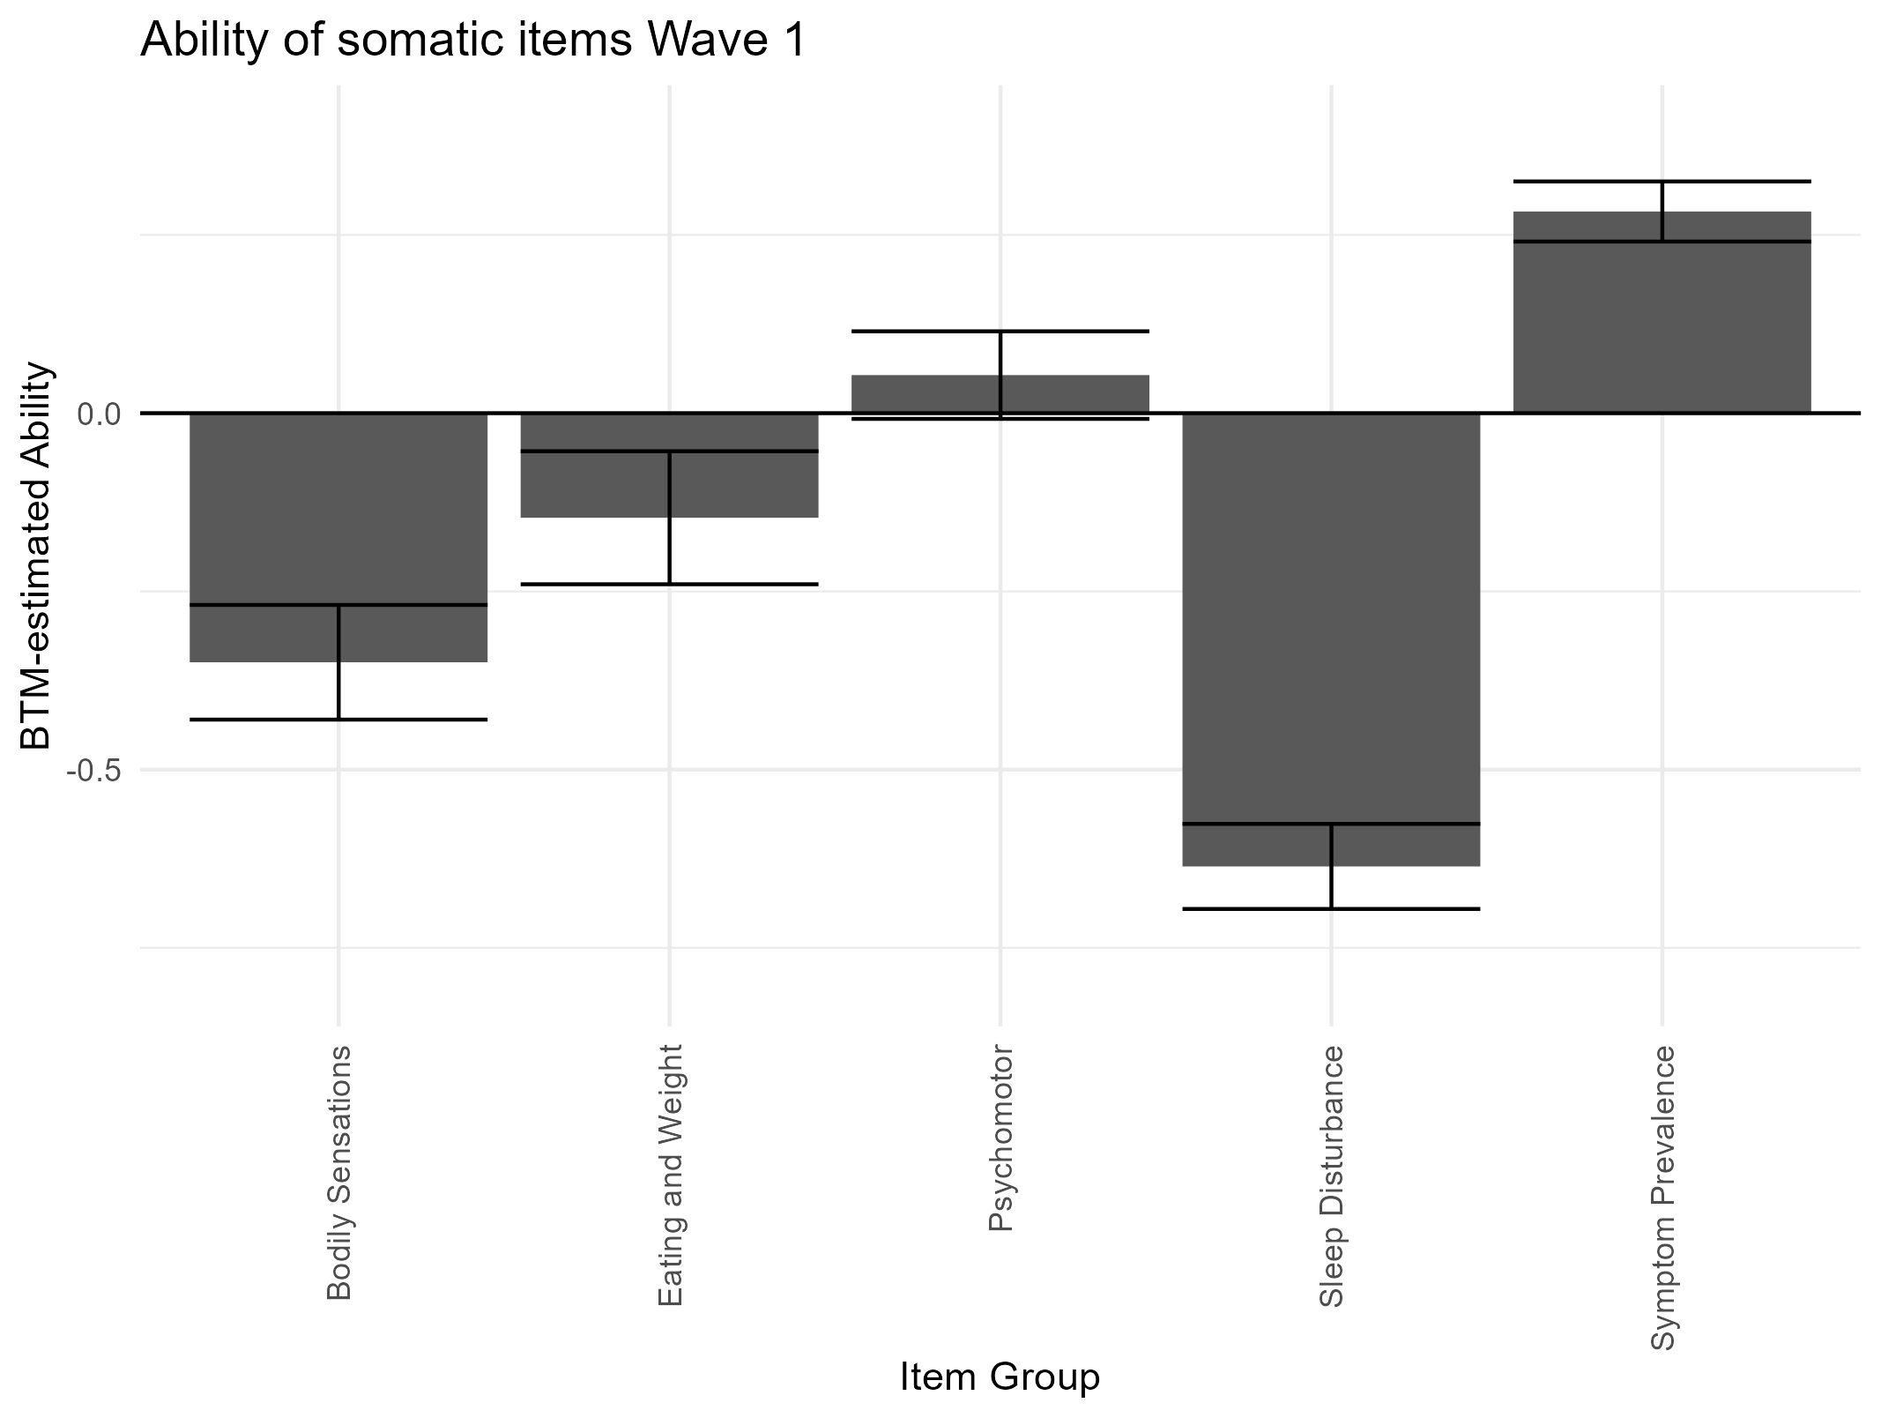
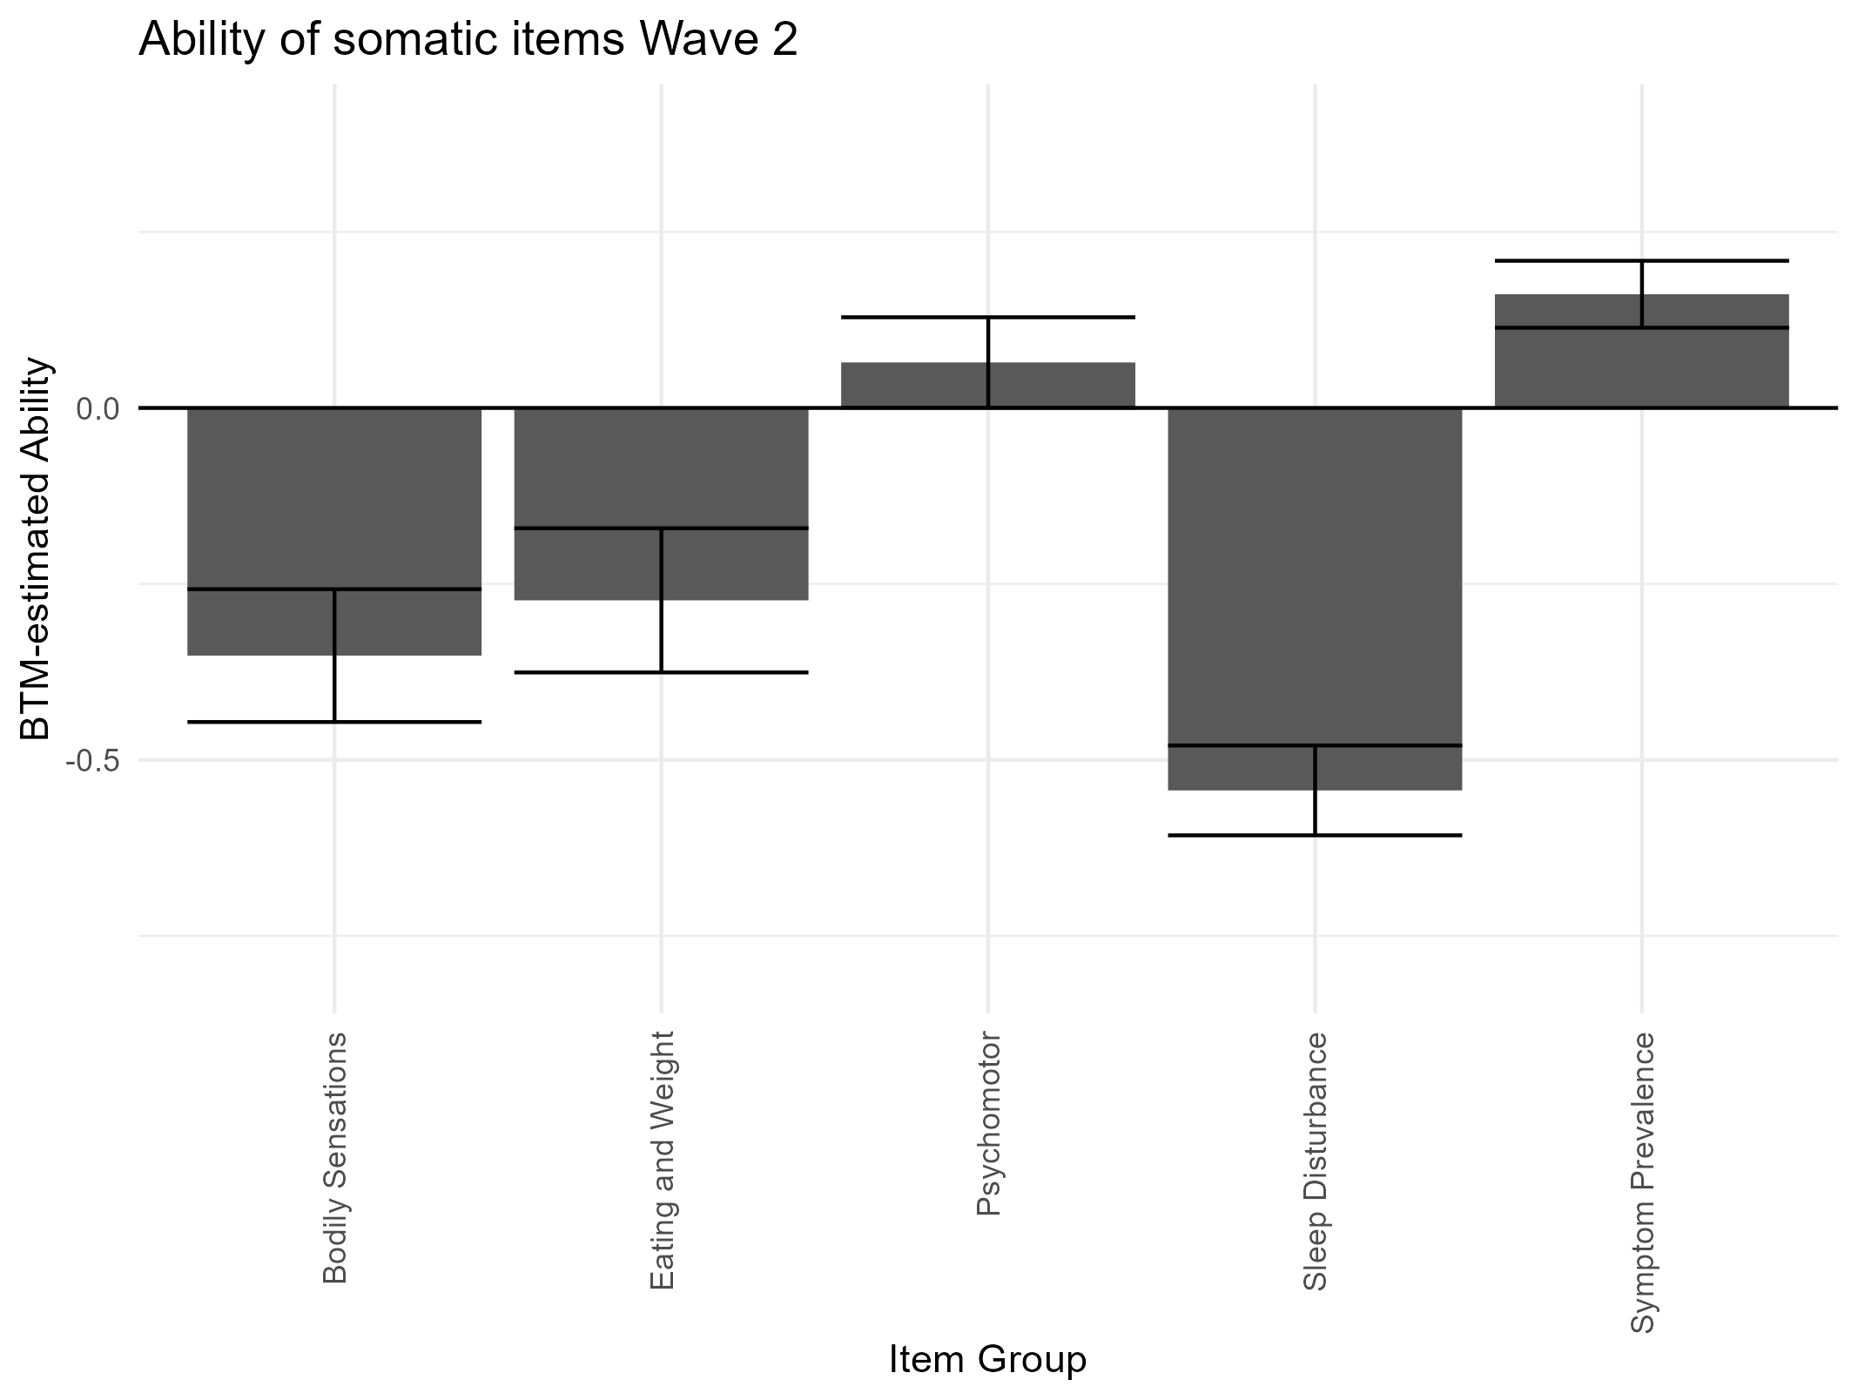
Is change in somatic items less preferred?
0 = Average preference of all non-somatic items
Symptom prevalence: Number of participants who nominated that symptom. (0 if < median, 1 if > median)

Slide 22
Why is change in somatic symptoms less preferred?
Predictor | Symptom type | Beta (standardised) | SE
Age | Eating | 0.08 | 0.06
 | Sleep | -0.22* | 0.03
 | Bodily Sensations | 0.04 | 0.05
 | Psychomotor | -0.07 | 0.03
Depression | Eating | -0.20* | 0.05
 | Sleep | -0.16* | 0.03
 | Bodily Sensations | -0.14* | 0.04
 | Psychomotor | -0.01 | 0.03
p < .004, i.e., significant after Bonferroni correction
Larger beta = More likely to pick this item in forced choice
Results from wave 1 only, but replicate in wave 2
Sex/Gender could not be included due to complete separation

Slide 23
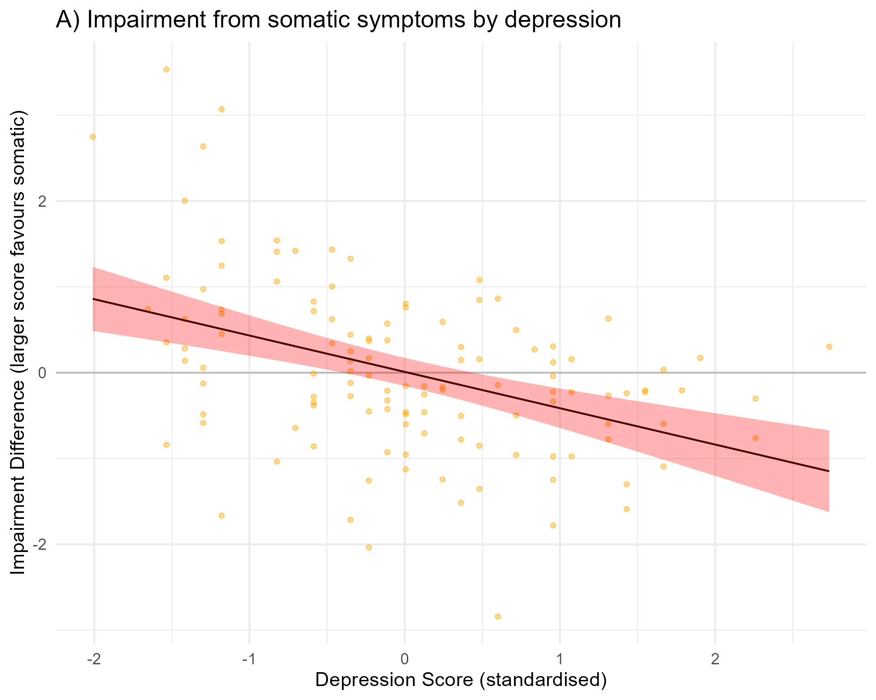
Why is change in somatic symptoms less preferred?
beta = -0.42, SE = 0.08
All results wave 1
“Somatic” is coded 1 for all somatic items, excl. psychomotor

Slide 24
Summary
People who are more depressed are less likely to pick somatic symptoms (except psychomotor) as the symptom they want to change
This may be because the impairment from somatic symptoms, relative to non-somatic symptoms, seems to be lower in people with more severe depression.
Why?

Slide 25
Usefulness: How much variability is there in preference?

Slide 26
Usefulness: Who is particularly (in)decisive?
Computed an ‘decisiveness score’ based on the ratio of observed and maximal entropy in a participants’ preference profile.
Larger scores = more decisive, min = 0, max = 100
‘Decisiveness’ increased with age: A decision tool may be more useful in young participants
Wave 1 | Sex | Age | CESD-score | Decisiveness
Sex | 1 | -.11 | -.23 | -.01
Age |  | 1 | -.18 | .31*
CESD-score |  |  | 1 | -.19
Decisiveness |  |  |  | 1
*significant at alpha = .008 after Bonferroni correction

Slide 27
The project goal
Yes.
Can we measure preference for symptom change with forced choice, and is this worthwhile?
Probably.

Slide 28
Next steps

Slide 29
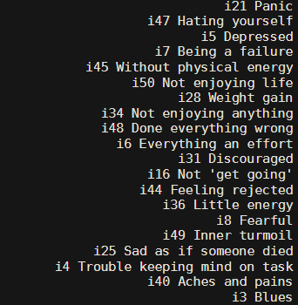
What’s our product?
Top 20 symptoms of an average participant,
who has all 52 symptoms in the questionnaire:

Slide 30
What’s our product?
Top 20 symptoms of an average participant,
who has all 52 symptoms in the questionnaire:
Can we trust this, and make it relevant to the surprise project?

Slide 31
What’s our product?
Top 20 symptoms of an average participant,
who has all 52 symptoms in the questionnaire:
How can we use it in research?
Can we trust this, and make it relevant to the surprise project?

Slide 32
What’s our product?
Top 20 symptoms of an average participant,
who has all 52 symptoms in the questionnaire:
How can we use it in research?
Can we trust this, and make it relevant to the surprise project?
What, if anything,
is it good for in practice?

Slide 33
Goals
Psychometrics of forced choice
Can we replicate our findings in a second sample?
Can we construct a similar questionnaire for anxiety?
Understanding mean trends in preference
What other demographic variables affect preference (in particular of somatic versus non-somatic symptoms)?
Ethnicity, past service use, income/SES, education, anxiety-symptoms?
Do we see a similar pattern in anxiety patients?
Opportunities for individualisation
How does preference impact treatment choice?
Who has most difficulty choosing?
How do participants perceive the usefulness of such ‘symptom rankings’?

Slide 34
Task design: one depressed sample, one anxious sample
Participants with probable depression (CESD > 16) OR social anxiety (mini-spin > 6)
Select symptoms which appear in forced choice
Forced choice:
Depression OR Anxiety version & Likert ratings
Decisional conflict
Treatment choice
Qualitative evaluation
Demographics, CESD, Mini-SPIN
“Which of these symptoms bothered you in the last 6 months?”
“If you could make one of those symptoms go away, which one would you pick?”
“The decisions were easy for me to make.”
“Which of these two treatments would you choose?”
“What could this be useful for?”
ca. 10 min
ca. 5 min
ca. 40 mins
ca. 5 mins
ca. 10 mins
ca. 10 mins

Slide 35
Use in research: Demographics
In the first analysis, we could not examine gender effects due to complete separation. However, gender may plausibly have a huge impact! So, need to examine (if need be, in a combined dataset)
Education and knowledge about mental health may impact what we prioritise, so examine the impact of education (in general) and past help-seeking behaviour

Slide 36
Use in research: Why include ethnicity/race?
Ethnicity can affect the way people present with depressive symptoms:
Particular patterns of somatic distress emerge in different cultures (e.g., ‘Herzinsuffizienz’ versus ‘ataque de nervios’; Payer, 2010)
Certain ethnicities are more likely to report somatic symptoms of depression. E.g., in the US: Depressed African American or Latin American women report more somatic symptoms than white or Asian American women (Lara-Cinisomo et al., 2020)
Expectations of what and how much ‘somatic symptoms’ co-occur with depression influence practitioners’ decision-making, and may reinforce health disparities (Bagayogo et al., 2013)

Slide 37
Use in research: Ethnicity/Race
Why are there differences in reporting of somatic symptoms across ethnicities?
Measurement artifact? Variation in severity depression in ethnic minority groups (e.g., Flores et al., 2021; lower incidence but higher severity of depression in African American Adults)
Genuine variation? Variation in illness models (Kirmayer & Sartorius, 2007) and culturally-shaped ‘feedback-loops’.
Fear of stigma? Over-reporting of somatic symptom due to fear of stigma? (e.g., Nadeem et al., 2007; Ryder et al., 2008)

Slide 38
Use in research: Ethnicity
The concept of symptom preference may help get a clearer picture.
Measurement artifacts: Forced choice rules out over-reporting due to overall severity.
Genuine variation or fear of stigma? In all likelihood, both of these explanations play a role. Forced choice tasks alone won’t ‘settle’ this. But, to get a better view, we’d want to rule out measurement artifacts first!

Slide 39
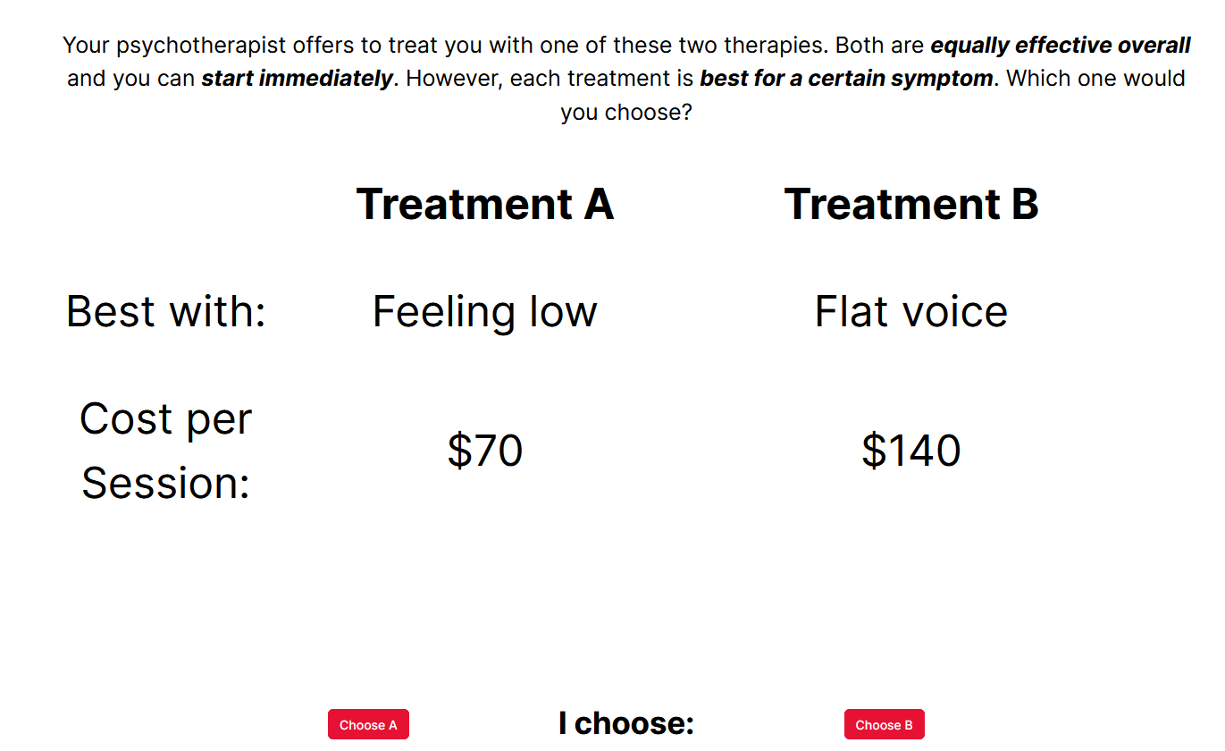
Individualisation: Treatment choice

Slide 40
Individualisation: Decisional conflict
If we know who has difficulty with choosing between the symptoms they want to prioritise, this could help us understand where a ‘ranking tool’ might be most useful’
In the first study, the entropic profile of the response distribution was negatively associated with age: Young people were less decisive than older people.
We inferred this from their choice behaviour, but what about their subjective experience?

Slide 41
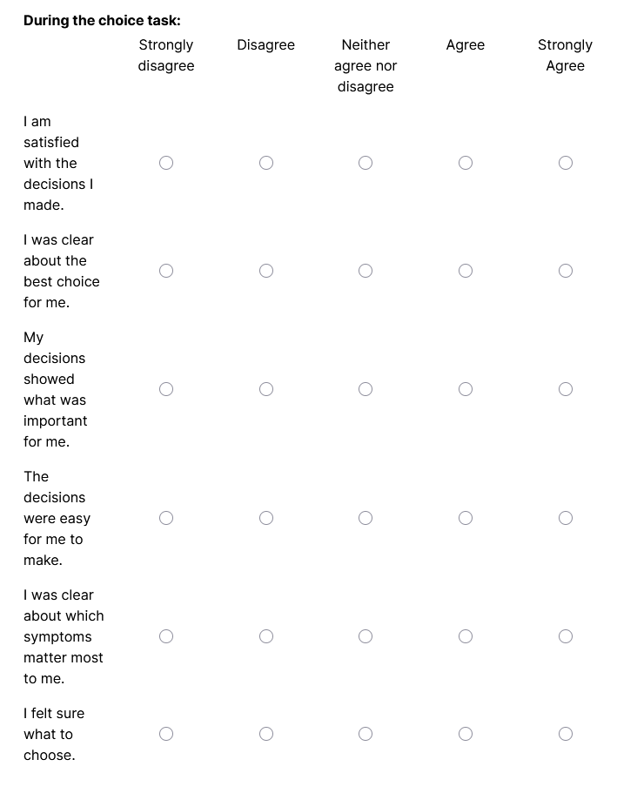
Adapted from O’Connor, 1995

Slide 42
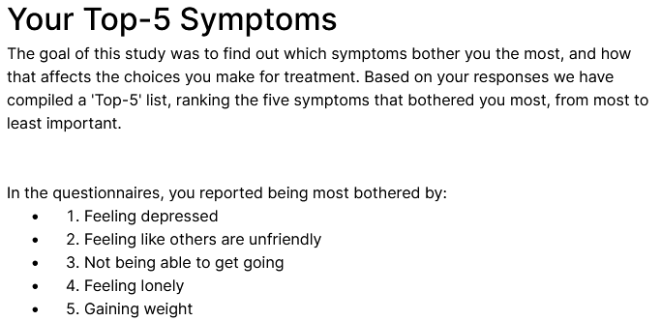
Individualisation: Mixed methods evaluation
Accuracy?
Potential
Helpfulness?
Potential Harmfulness?
Using mix of Likert items and free text responses.

Slide 43
Questions for you:
Operation in a terminological vacuum: How can be refine the notion of ‘symptom preference’?
What methodological or ethical concerns need to be addressed? (e.g., pre-screening, presentation of hypothetical ‘treatments’)
How can we make something useful out of this? How could we get more feedback from patients and practitioners, with a particular eye to young people?
How does this project fit (or not fit) within the current work at the AIM-lab? What synergies can we exploit?
What’s missing?

Slide 44
How has preference been conceptualised? The PEX-Questionnaire - Sandell et al. (2011)
Activities in treatment
Beliefs about activities
Treatment packages
Preference
Internalisation: Understanding the problem
CBT
Credibility:
Good rationale? Stressful? Challenging?
Externalisation:
Getting practical solutions
Psychodynamics
“I prefer CBT”
Helpfulness:
Will this help me with my specific problem?
Catharsis:
Get feelings out
Systemic Therapy
Defensiveness:
Get feelings in

Slide 45
Summary
Considering false negative rates, most participants seemed not be responding at random
Participants prefer to change symptoms that are more frequent, severe and impairing
Response processes were as expected, with participants responding more slowly on similarly-ranked items
There was much variability in participants’ preference profiles
Younger participants had less ‘decisive’ response profiles.

Slide 46
Summary
Alleviation of somatic versus other symptoms seemed to be dispreferred compared to non-somatic symptoms
We observed a dissociation between preference and symptom impairment
Depressed participants had lower preference to change their somatic symptoms (except psychomotor)
However, impairment from somatic symptoms relative to non-somatic symptoms increased with higher levels of depression

